Slide 1
Work Flow
Civil3D
Modeling
Structure
Analysis
(RSA)
(RST)
(ASD)
Alignment
Design conditions
Profile
Gravity load
Wind load
Shock
Brake load
Assembly
SAC
Bridge
Section
Mechanics
Compressive
Road
Section
Bending
Shearing
Corridor
Material
Foundation design
Intersection
Steel
Reinforced concrete
...
Supports
...
Prestressed concrete
...
Foundation
...
Drawings & Reports
Notes:
RSA : Autodesk Robot Structural Analysis Professional
RST : Autodesk Revit Structure
ASD : AutoCAD Structural Detailing

Slide 2
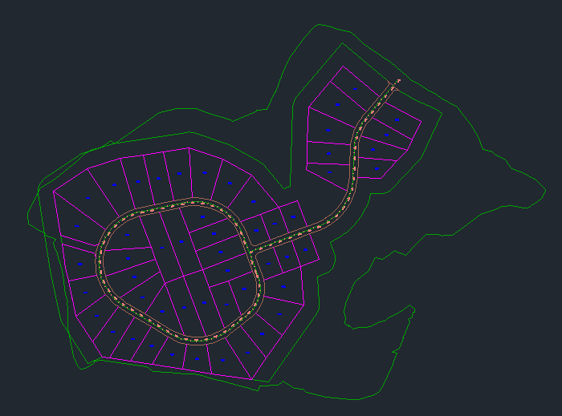
Alignment

Slide 3
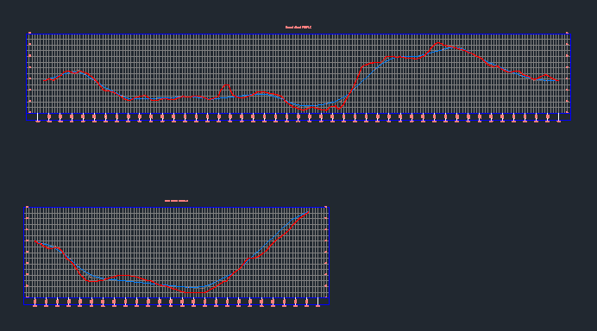
Profile

Slide 4
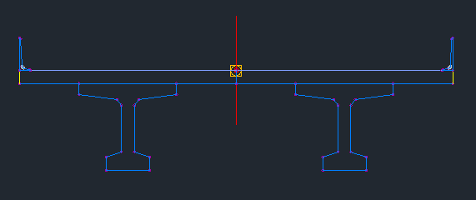
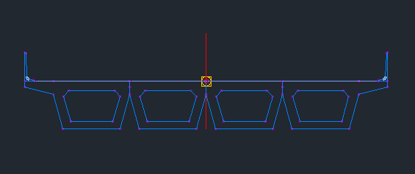
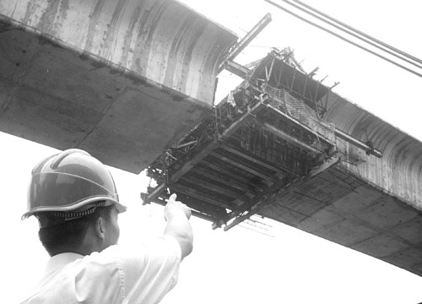
Assembly
Bridge
Section

Slide 5
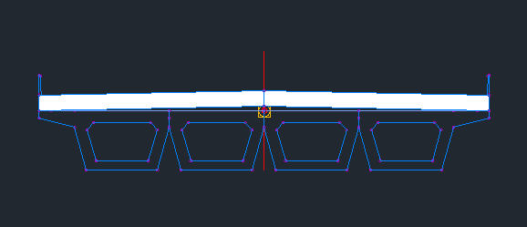
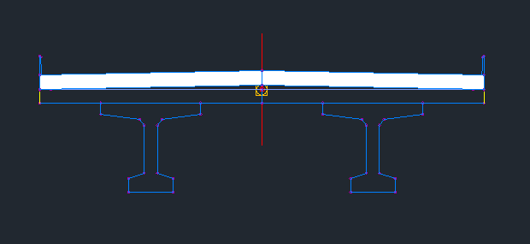
Assembly
Road
Section

Slide 6
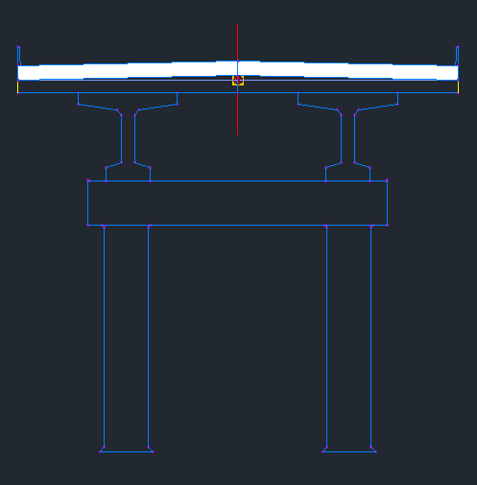
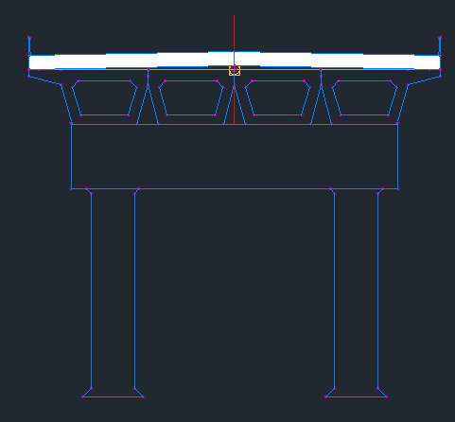
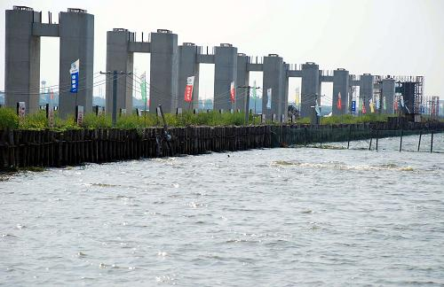

Supports

Slide 7
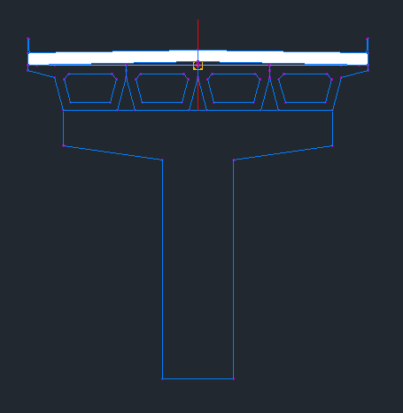
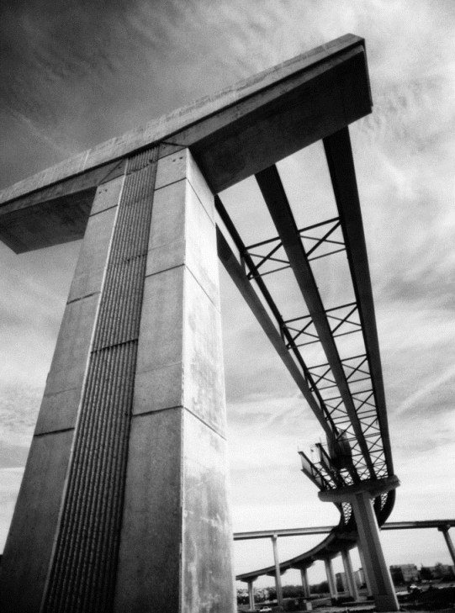

Supports

Slide 8
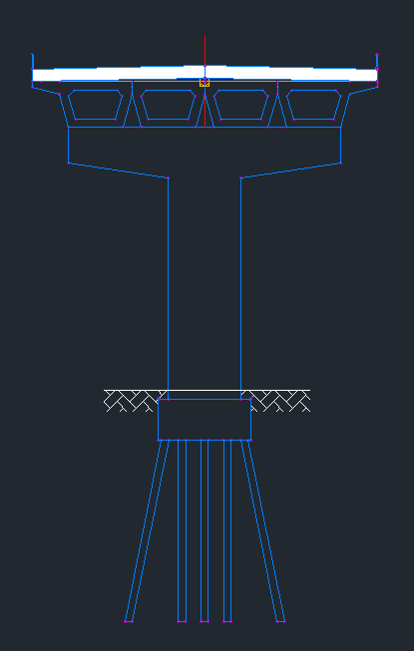
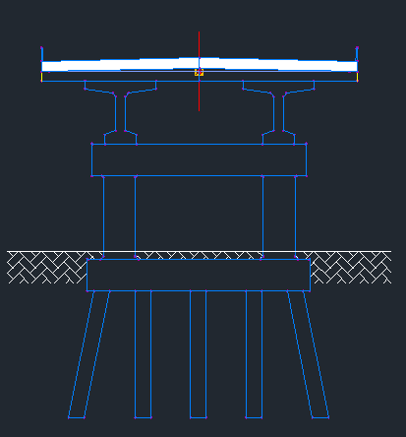
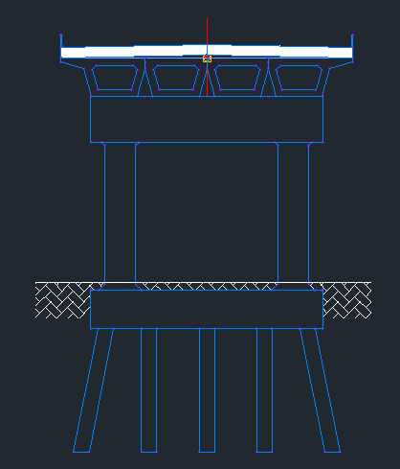
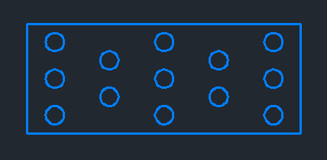
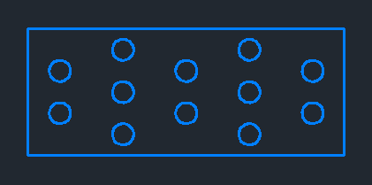
Foundation

Slide 9

